Slide 1
2019 Tax Return Information For Mr. & Mrs. Smith
Name

Slide 2
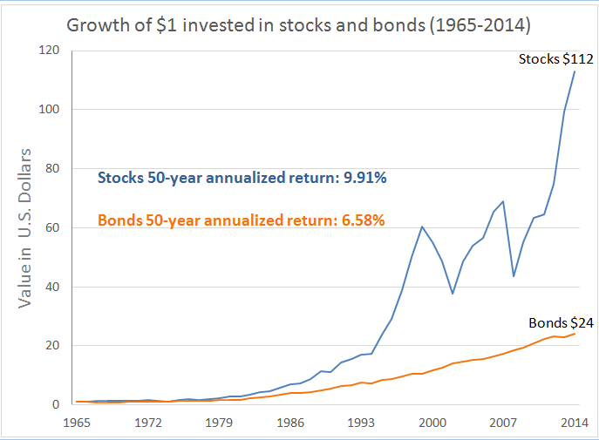
Investment opportunities
Historically, Stocks returns has always surpassed bonds historically.
Stock have registered an average of 10% returns compared to 5% return on stock
Bonds returns are less volatile and risky compared to stocks
Equally, municipal bonds are less risky and are important in the development of a municipality

Slide 3

Municipal Bonds
General Obligation Municipal Bonds
Revenue Municipal Bonds
Backed by the municipal creditworthiness and its ability to levy and collect taxes.
They are not backed by any collateral
Amount of taxation may be limited or unlimited
If unlimited, a municipal may increase taxes levied to its resident to meet its bond obligations
Repayment of the obligation is primarily guaranteed by the operating revenues of an entity
The repayment is guaranteed only by revenues obtained by the projects that were subsidized using the bonds
Tax revenues are not used at all.

Slide 4


Tax Planning strategies
Conversion Strategy
Implicit Taxes
Effective tax planning reduces the tax liability or defers them increasing the cash available for investment
Takes advantage of changes in taxation across different activities
For example, shifting from traditional investment to alternatives investment vehicles
Implicit taxes is the effect of taxes on an investment asset
Leads to reduction in the return on a tax-favored investment
If an asset is tax preferred, its price will be higher to reflect that attribute
Common example is the yield on the municipal bond

Slide 5
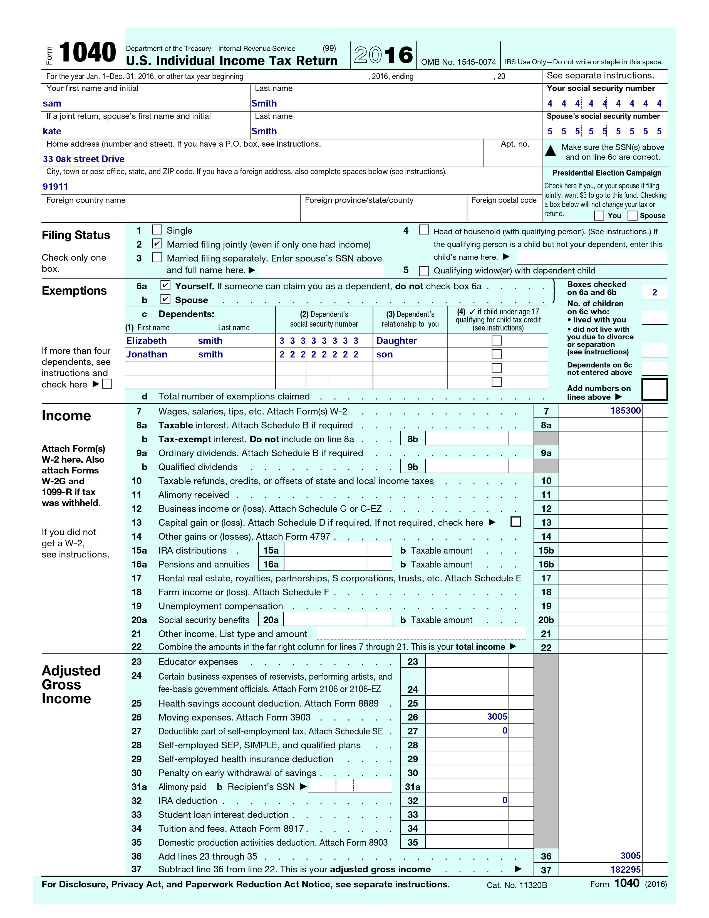
Form 1040
Form1040- A mandatory form for U.S. taxpayers to file an annual income tax return

Slide 6
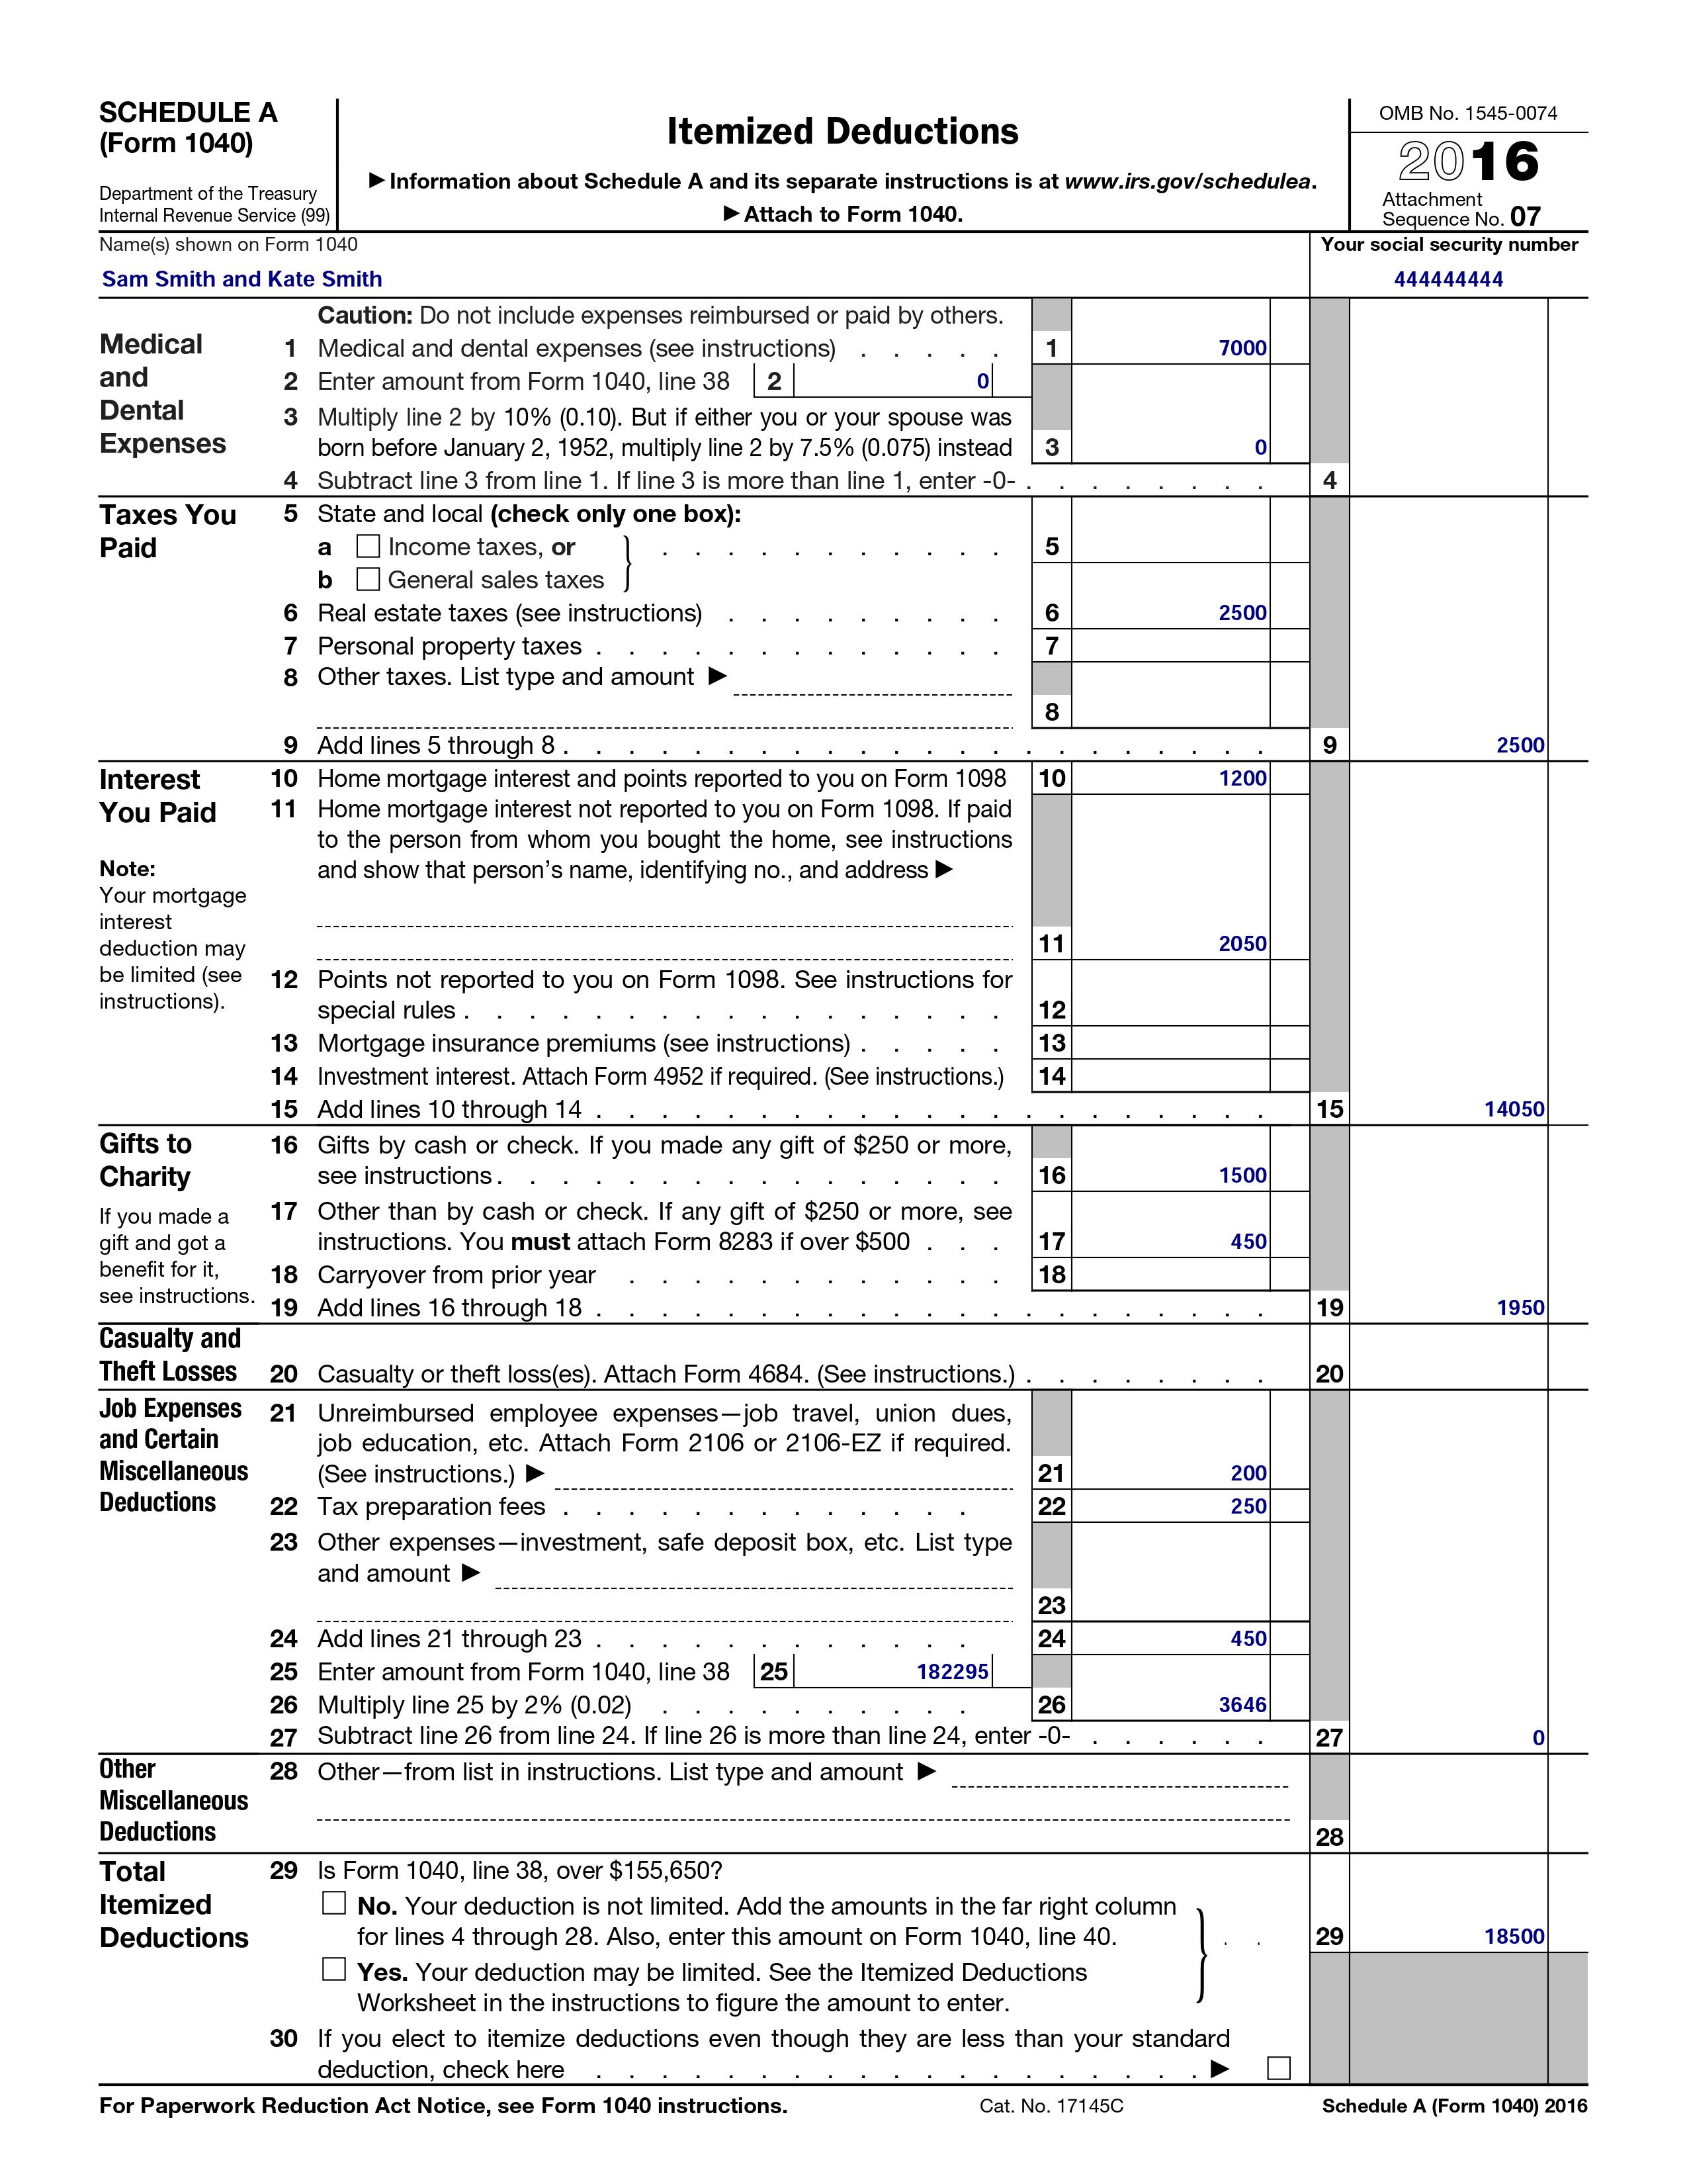
Schedule A
Schedule A- An extension of form 1040 for itemized deductions

Slide 7
Itemized Deductions or Standard deduction
STANDARD:
A fixed amount of deductions that lowers your taxable income.
Home interest $12,000
Real estate tax $2,500
Charitable contributions $1,800
ITEMIZED:
Deductions that are made up of a list of eligible expenses
Non-Deductible expenses includes
Personal credit card interest
Union dues and Tax preparation fees
Moving expenses and Student Loan Interest

Slide 8
Steps involved
figure out your adjusted gross income (AGI)
    [gross income – deductions]
Apply the tax rate ( provided by the IRS) to the taxable income
Fill out any other relevant information such as credits
Establish a the outstanding tax liability or return.

Slide 9
References
Gale, William G., Hilary Gelfond, Aaron Krupkin, Mark J. Mazur, And Eric Toder. 2018. “Effects Of The Tax Cut And Jobs Act: A Preliminary Analysis.”
Https://Www.Taxnotes.Com/Tax-notes-federal/Tax-policy/Taxation-and-valuation/2019/08/12/29rhn
Kennon, J. (2019, July 15). Get To Know The Two Big Categories Of Municipal Bonds. Retrieved August 21, 2020, From Https://Www.Thebalance.Com/General-obligation-vs-revenue-municipal-bonds-357926
Lanfeng Kao & Anlin Chen (2011): Dividend Policy And Elimination Of Double Taxation Of Dividends; Asia-pacific Journal Of Financial Studies.
Spilker, B. C., Outslay, E., Ayers, B. C., Barrick, J. A., Robinson, J. R., & Worsham, R. G. (2020). Mcgraw-hill's Taxation Of Individuals. New York, NY: Mcgraw-hill Education.

